Slide 1


Census Block Group American Community Survey
GROUP #3:
Nanjesh Ramesh
Monish Phatarpekar
Goutham Raj Ganesan
Sowrabh Shanthanand

Slide 2
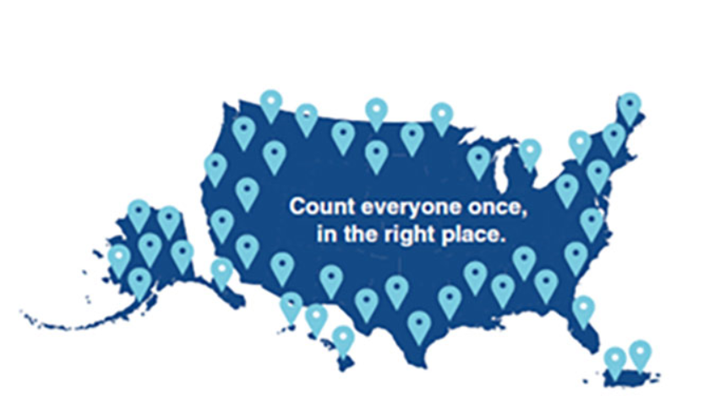
INTRODUCTION
Dataset size: 2GB
Queries to filter and categorize top important information.
URL: https://www.kaggle.com/safegraph/census-block-group-american-community-survey-data

Slide 3
OBJECTIVES
Learn how to use HiveQL, Power BI ,Tableau, Excel 3D maps.
To analyze the economic characteristics, such as income and employment and how they differ by neighborhood.
To analyze the characteristics, such as poverty status and standard of living with respect to the Census Blocks.
Comparison between the visualizations on various aspects.

Slide 4
SPECIFICATION
Dataset size: 2GB
Cluster version: Oracle Cloud 4.2
No of nodes: 6
Memory size: 180GB
CPU Speed: 2.2GHz
https://www.kaggle.com/safegraph/census-block-group-american-community-survey-data

Slide 5
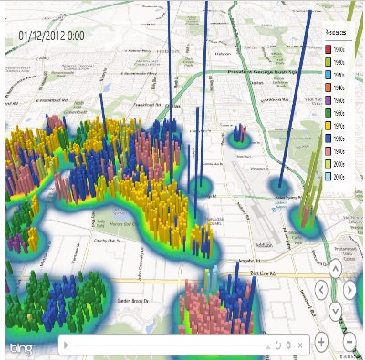



DATA PROCESSING
EXCEL 3D MAP
Census Block Group American Community Survey
POWER BI
TABLEAU

Slide 6



TOP 5 FAMILY INCOME IN CALIFORNIA
This graph shows the Census Blocks in California with highest Family-Income.
The census blocks across Camp Pendleton have recorded the family-income of $6.9k.

Slide 7
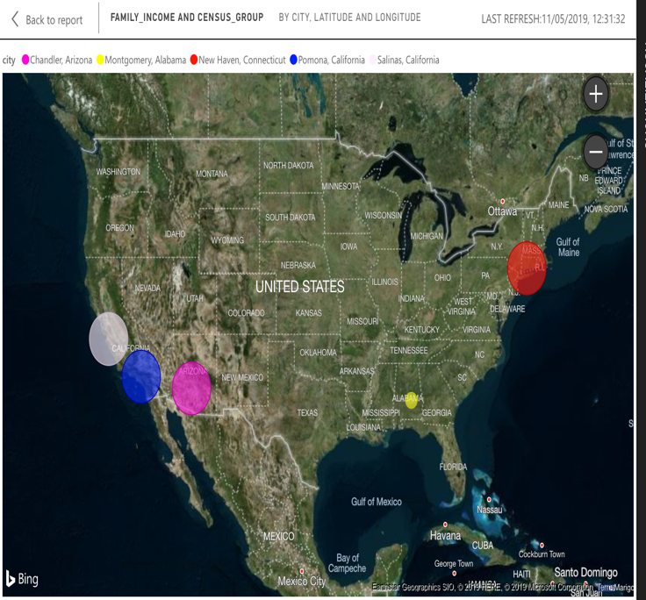
BOTTOM 5 FAMILY-INCOME IN CALIFORNIA
In this Map Visualization we have represented the Census Blocks with low family-income.
The Census Blocks in Montgomery City, Alabama State (yellow point on the map) has recorded low family-income.

Slide 8
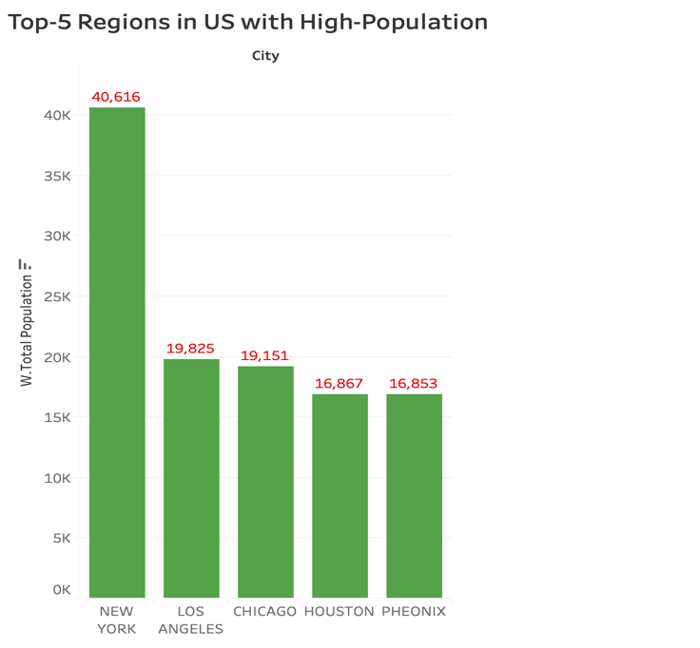
TOP 5 REGIONS IN US WITH HIGH POPULATION
This bar graph depicts the highly populated census blocks in the United States.
It is observed that the blocks in the City of New York is densely populated with 40,616 people, followed by Los Angeles which has a population of 19,825.

Slide 9
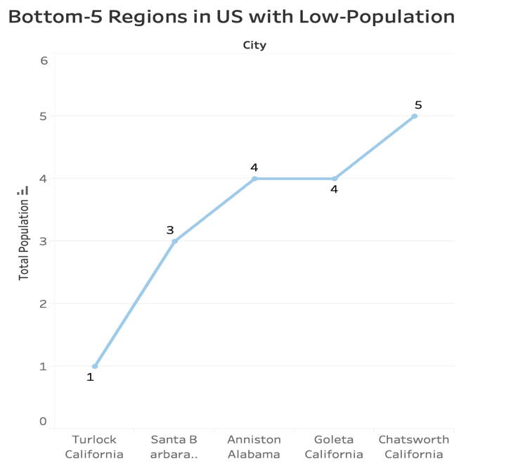
BOTTOM-5 REGIONS IN US WITH LOW POPULATION
This line graph represents the low populated census blocks in the United States.
It is observed that the blocks in the City of Turlock has less people per square area which is further followed by Goleta and Chatsworth.

Slide 10
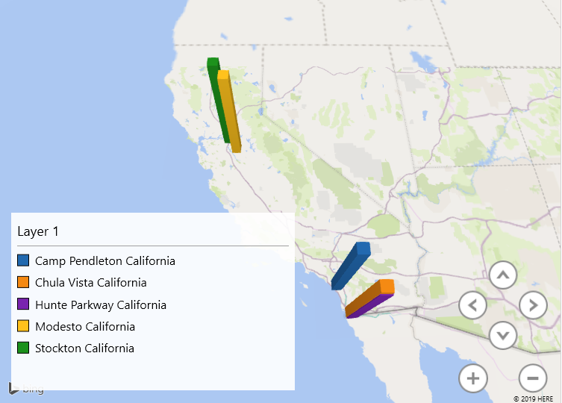
REGIONS HAVING HIGHER HEALTH INSURANCE COVERAGE
In this 3D-Map representation we have plotted the regions in California with greater Health insurance Coverage.
It is observed that Modesto, Stockton, Hunte Park, Chula Vista and Camp Pendleton have people whose health insurance coverage is significantly high.

Slide 11
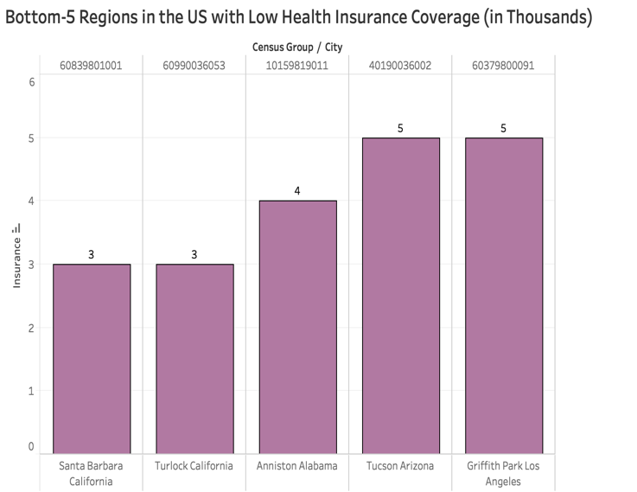
REGIONS HAVING LOWER HEALTH INSURANCE COVERAGE
The bar graphs represents the regions in which the blocks have lower health insurance coverage.
We noticed that the city of Santa Barbara and Turlock had blocks with lower insurance coverage followed by Anniston and Tucson.

Slide 12
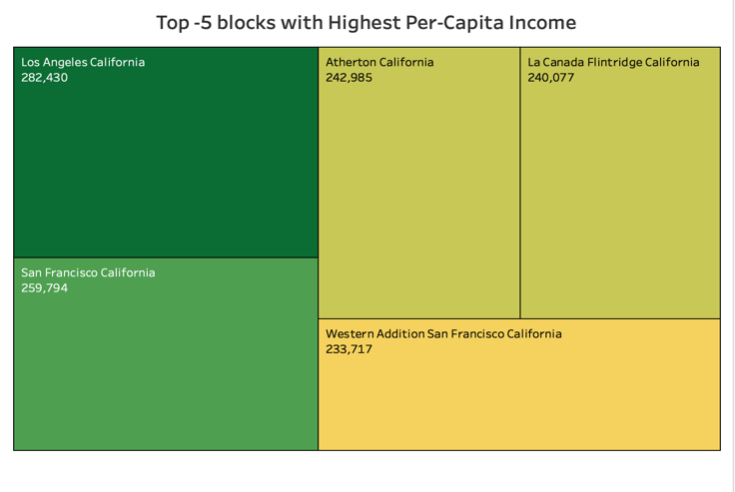
REGIONS HAVING HIGHEST PER CAPITA INCOME
This is a tree-map representation wherein the larger the size and darker the color signifies a greater value and vice versa for the smaller value.
As per the above visualization the City of Los Angeles has the highest per-capita income of $282,430 followed by San Francisco $259,794.

Slide 13
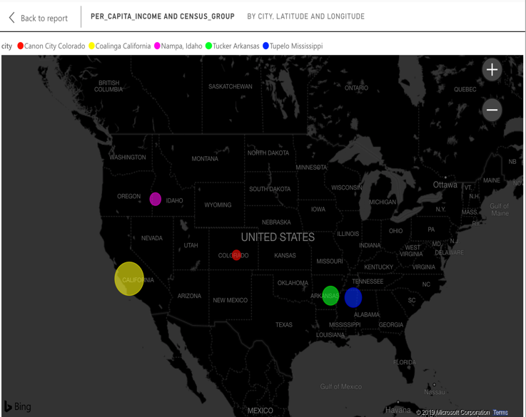
REGIONS HAVING HIGHEST PER CAPITA INCOME
In the map representation we can observe the regions with low Per-Capita income. Canon City in Colorado State (red color) has the lowest average earnings per square area followed by Nampa city in Idaho and Tucker city in Arkansas state.

Slide 14
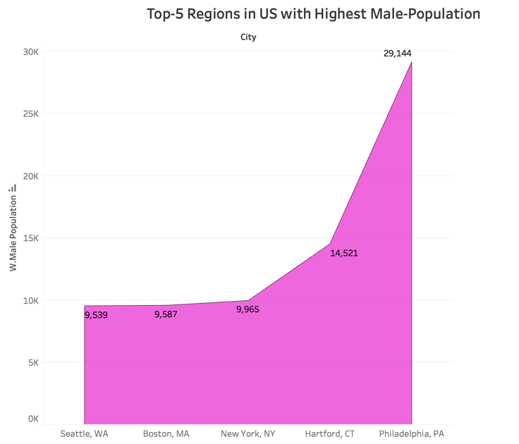
REGIONS HAVING HIGHEST MALE POPULATION
This representation is called area under the curve which is giving us a clear insight about the regions with greater male population.
It is observed that the city of Philadelphia has blocks with 29,144 males followed by Hartford (14,521 males), New York (9,965 males) and so on.

Slide 15
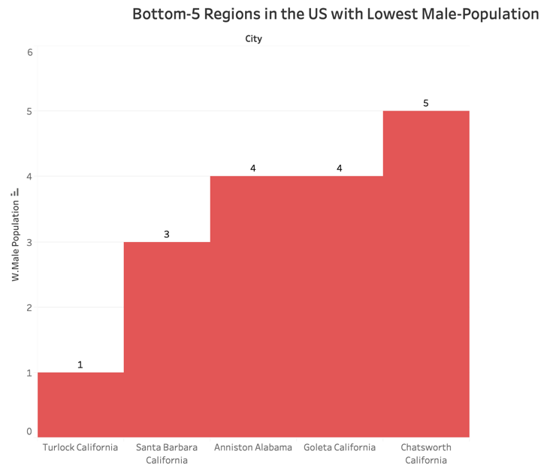
REGIONS HAVING LOWEST MALE POPULATION
This representation is called step representation which is giving us a clear picture about the regions with lower male population.
It is observed that the city of Turlock in California has blocks with fewer male population followed by Santa Barbara, Anniston in Alabama and so on.

Slide 16
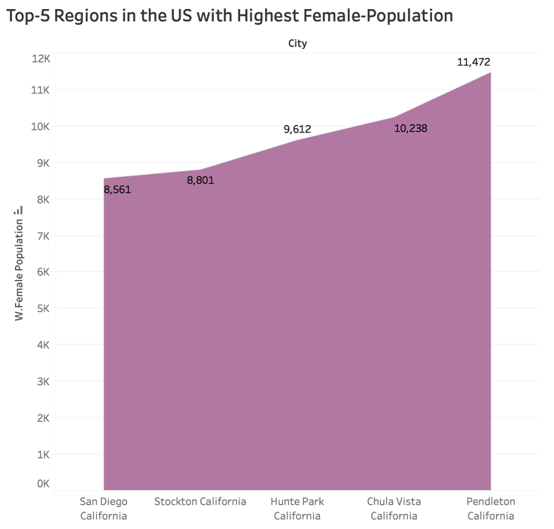
REGIONS HAVING HIGHEST FEMALE POPULATION
The area under the curve representation shows the region-wise count for highest female population.
It is evident that Pendleton city is having the highest female population followed by other cities such as Chula Vista, Hunte Park, Stockton and San Diego.

Slide 17
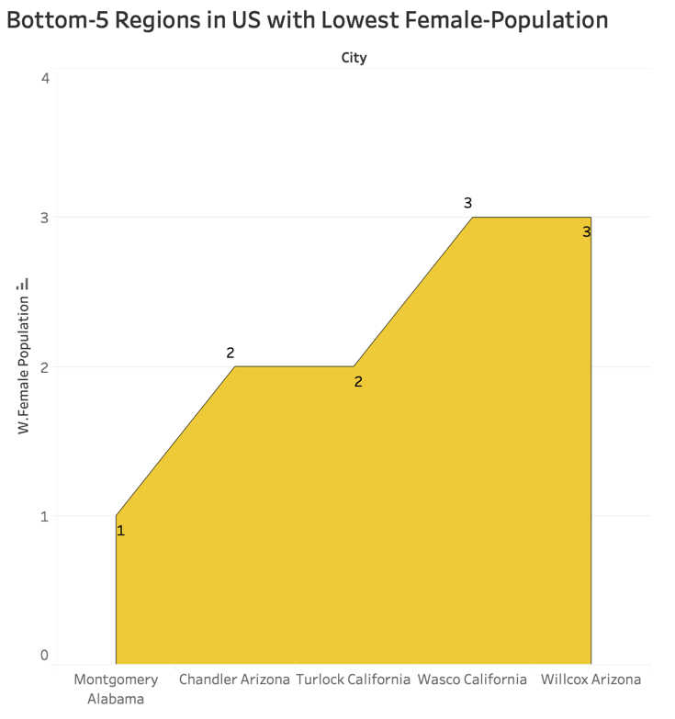
REGIONS HAVING LOWEST FEMALE POPULATION
The area under the curve representation shows the region-wise count for lowest female population.
It is evident that Montgomery city in Alabama is having the lowest female population followed by other cities such as Chandler in Arizona, Turlock in California and so on.

Slide 18
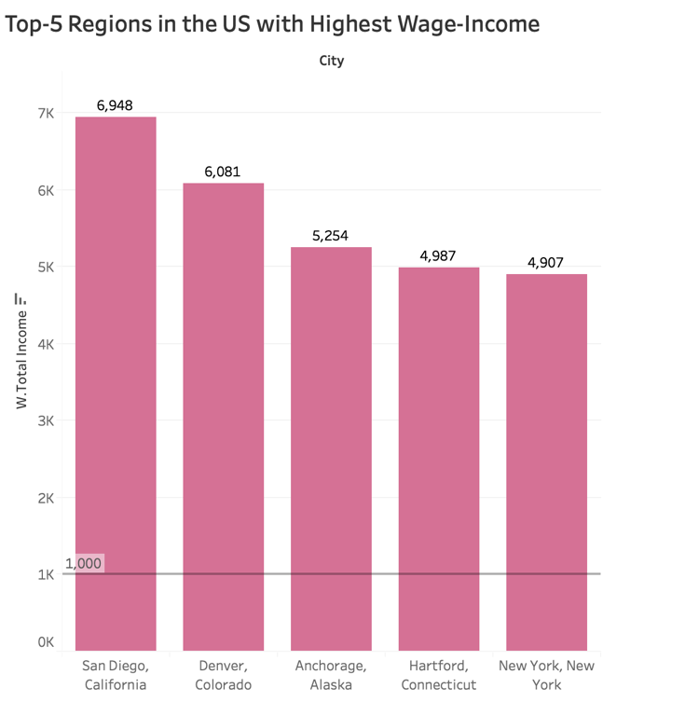
TOP-5 REGIONS IN THE US WITH HIGHEST WAGE-INCOME
This bar graph represents the Wage-Income corresponding to different regions.
It is observed that blocks in San Diego have the highest wage income of $6948 followed by Denver, Colorado with a wage income of $6081.

Slide 19
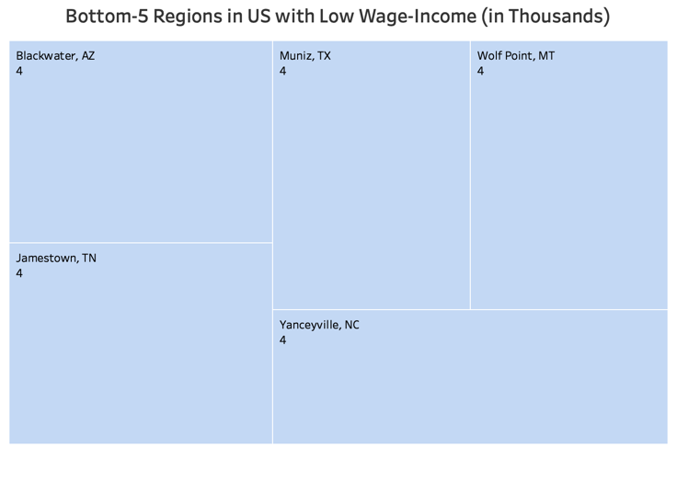
BOTTOM-5 REGIONS IN THE US WITH LOW WAGE-INCOME
This tree-map representation depicts the regions with lower wage incomes.
It is observed that the cities such as Blackwater(AZ), Muniz(TX), Wolf Point(MT), Jamestown(TN) and Yanceyville(NC) have the lowest wage income.

Slide 20
SUMMARY
Successfully used many tools learned in class such as HiveQL, Oracle Cloud, Power BI, Excel 3d Maps and Tableau to use and visualize data.
Majority of the Census Blocks in the United States are active.
Tuesday is the busiest day of the week in terms of visits to brands/stores.
Los Angeles has blocks with high annual income.
Per-Capita Income is greater for the male population.

Slide 21
REFERENCES
https://www.kaggle.com/safegraph/census-block-group-american-community-survey-data
http://proximityone.com/geo_blockgroups.htm
https://en.wikipedia.org/wiki/Census_block_group

Slide 22


